Slide 1

Addis Ababa University Addis Ababa Institute of Technology Center of Information Technology and Scientific Computing(ITSC)
Department Of Software Engineering
Section – 3
Developed By:
1.Beleyhun Arage
2.Endalkachewu Yalew
3.Fantahun Fekadu
4.Mekdes Genetu
5.Samuel Adnew
6.Meti Tadele
Advidisors: -Mr. Kassahun A.
-Mis. Fikir
July 2019 GC

Slide 2
INTRODUCTION
Due to development of world and the advent of information and communication technology through different communication medias for the sake of information exchange has led this world to a narrow village and has solved multiple problems . But , the existence of some unresolved problems and difficulties shows the existence of some problems that should and could be resolved using the technology. Even if solving a problem is not a one night task , observing and trying to solve your things using the material near you is a vital way of using the technology.
In our country context , the problem related to searching and finding individuals for different reason without fill information or interference of cajolers is difficult thing that our society forced to face. From those searching for maids or indoor worker who can satisfy your and your families amiss at home and can communicate with you easily is the need of most families especially for most families some maids could be their life time life time servant and life long families because of the presence of those maid from happiest moment to the saddest moment of the family. But , looking for such workers is one of the tedios thing to face so that the Employer would be forced to go to the worker who have a connection to find them a good employee and pay a lot of money for that service.

Slide 3
Introduction cont...
One of the other looking we observe and that needs to be solved using the technology is the challenge for having a mate who could fulfill your criterion and who match your physical and cast of mind preference. For many cases the first cause for divorce is the unrelated cast of mind of the two individuals. But, trying to find a mate with those personality in your vision is the most difficult and tedious task to go through.
Additionally, the tutor need of most students due to their heavy load of study ,unable to understand things your way due to some different way of view or the need to have additional course apart the regular study curriculum using your time going nowhere was un some of the difficulties for students to see their study harder way.

Slide 4
Introduction cont..
Finally, after reading this all challenges and problem above we can think of what material near you can solve this problem. Well, as we all know the presence of some diversely introduced electronic devices like mobile phone , computer create a network known as web using that platform and the existence of this medias everywhere makes the exchange of information using those medias a best way. So that, in our project we will be using those medias to make the information’s related to situations listed above be accessible and usable around the world using the previously mentioned devices and without any fee for any cajoler(broker) every one can register and search for a maid or indoor worker near his or her village or search for a tutor online expert in his course or search for a tutor who resides in or near your village and communicate or search for a mate that has a personality as you need and chat with using the platform . This is all we are trying to introduce.

Slide 5
Purpose of The System
The main purpose of the system is to develop a website which helps users find their choice online.

Slide 6
Scope
Our system Afalagi which w are going to develop is a system which contains three different template platforms giving distinct services.
There are three services we are going to develop in this semester (Given amount of time ) are as follow-:) the system will be developed starting from front end and the elements of the three platforms will be finished encompassing the a forms database , interactive frontend features and the page will be expected to have some interactivity with the database and the users can be able to see permitted the data of the user including the address. So that, they can communicate using the addresses find in the site and the communication or chatting on our web site using the platforms like video chatting, text Chatting, voice calls etc will not be in this phase of development of the project. Simply in this in the platform the user will be able to share there addresses and links addresses.

Slide 7
Scope cont.…
1. users can be able to register and be a official user of the site and additional services that need additional profile of the user and force the users to create additional specifically functioning account.
2. The every user will have the capability that doesn’t need additional information such as watching a tutor doesn’t need any other account. But, dating sites and maid and worker interactions and also a tutor person need to have an account in accordance with the service requirement.
3. we will be using interactive server to response for the user actions which control the user interaction with the database.
As we tried to show above we planned to develop a simple interactive web site in this semester.

Slide 8
Requirement of the System
Functional Requirement
The official definition of ‘a functional requirement’ is that it essentially specifies something the system should do.
Afalagi system does the following.These are:
- Users can find their date mate.
- Users can find and employee home maid.
- Users also can employee lecturer or teacher.

Slide 9
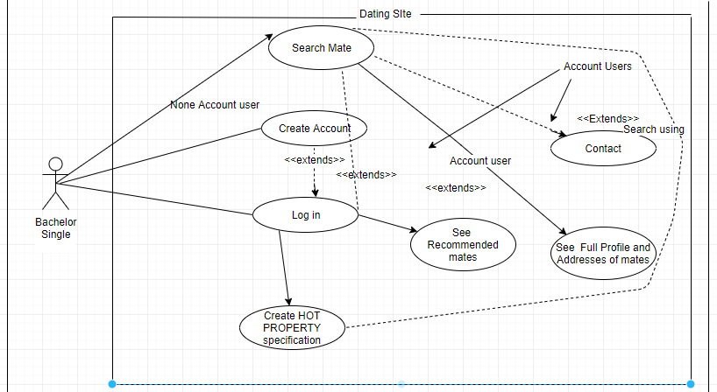
Use case

Slide 10
Non-Functional Requirement
The definition for a non-functional requirement is that it essentially specifies how the system should behave and that it is a constraint upon the systems behavior. One could also think of non-functional requirements as quality attributes for of a system.
Our system Afalagi is database based system which meets non-functional requirements such as Performance – for example Response Time, Throughput, Utilization, Static Volumetric
Scalability, Capacity, Availability, Reliability, Recoverability, Maintainability, Serviceability, Security, Regulatory, Manageability, Environmental, Data Integrity, Usability, Interoperability.
Generally our system satisfies almost the above indicated non-functional requirements using different techniques.

Slide 11
Sub-system decomposition
This component or AFALAGI system is classified into multiple sub system the system has to include at the development of the system.
Administration Tools: This component is responsible for all the functionalities that only the web app controllers are allowed to use. It is decomposed into these sub systems.
Manage users: This contains the functionalities of adding / deleting users
Manage Reports: This contains the functionality of reviewing and delivering actions towards these reports.
Notification : This component is responsible for delivering notifications that rise form votes (up vote and down vote) comments and reports towards a given posted petition.
Communication to Database: the system users will communicate with the database and the server by using the queries on their machine (Browser).
System Components of the system : depending on the three platforms and the separation of the components of the system the system will be classified in to multiple components of the system.

Slide 12
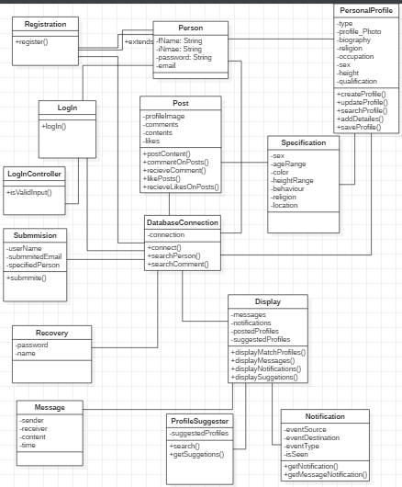
Class Diagram

Slide 13
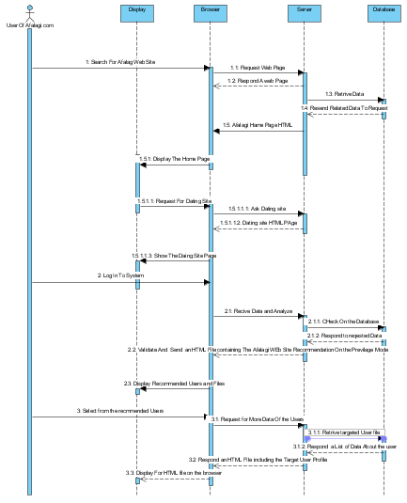
Sequence Diagram

Slide 14
Architecture of the system
The Layering of approaches , Three Tier Architectures and MVC – the system is composed of three components (tiers ) , Follows Layered Approach and Model View Control for the Design and development.
We have chosen the Three tier architecture because of Our system is Web based and the hardware and the software requirements of the system will be easily maintainable if the development Architecture goes in this way.

Slide 15
System Architecture cont.….
And the selected layer parts are :-
Presentation layer. This layer contains the user oriented functionality responsible for managing user interaction with the system, and generally consists of components that provide a common bridge into the core business logic encapsulated in the business layer.
Service layer. This layer is important when the application must provide services to other applications, as well as implementing features to support clients directly (System Administrators in our case).
Business layer. This layer implements the core functionality of the system, and encapsulates the relevant business logic.
Data layer. This layer provides access to data hosted within the boundaries of the system.

Slide 16
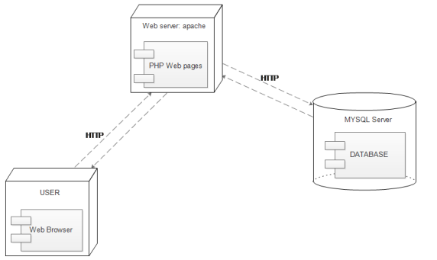
Deployment Diagram

Slide 17
Implementation
We have the implementation video with in the container folder. Go and refer to the implementation video to view the implementation of the system.

